Slide 1
Semantic Visualization of Acute Myocardial Infarction (AMI) Clinical Notes Using NLP Models
By
Sritama Paul
AI 395T | AI In Healthcare
University of Texas at Austin
Spring 2026

Slide 2
Objective
Compare semantic structure of AMI discharge notes using the following NLP framework/libraries
spaCy
sciSpaCy
medSpaCy
BioClinicalBERT
Techniques Used:
Named Entity Recognition
Embedding generation (word2vec, contextual)
Dimensionality reduction (t-SNE, UMAP)
Goal:
Evaluate clinical coherence, clustering behavior, and domain specificity.

Slide 3
Generate AMI Cohort
Identify Acute Myocardial Infarction (AMI) patients from MIMIC-III for NLP analysis
Filter DIAGNOSES_ICD dataset with ICD-9 Code 410.xx -> Acute Myocardial Infarction
Extract unique SUBJECT_ID and HADM_ID
Link them to NOTEEVENTS dataset and restrict them to `Discharge summary` category only
Cohort characteristics
Includes hospital admissions with confirmed AMI
Full discharge summaries
Medication section
Laboratory and procedure documentation

Slide 4
NER and Embeddings
Named Entity Recognition (NER) identifies what clinical concepts are present in the corpus such as
Diseases
Medications
Lab Values
Procedures
Severity
Word2Vec (Static Embeddings) answers which words appear in similar contexts
Assigns one fixed vector per word
Captures co-occurrence similarity
Dimensionality reduction (t-SNE, UMAP)
Contextual Embeddings (used in BioClinicalBERT) captures sentence level meaning
Each word embedding depends on sentence context

Slide 5
Initial Set Up in Jupyter Notebook
%pip install spacy==3.6.1
%pip install scispacy==0.5.3
%pip install medspacy
%pip install gensim
%pip install umap-learn
# Install en_core_web_sm model for spaCy
%pip install https://github.com/explosion/spacy-models/releases/download/en_core_web_sm-3.6.0/en_core_web_sm-3.6.0-py3-none-any.whl
# Install en_core_sci_md model for SciSpaCy
%pip install https://s3-us-west-2.amazonaws.com/ai2-s2-scispacy/releases/v0.5.3/en_core_sci_md-0.5.3.tar.gz

Slide 6
Charts produced
01 | tSNE Plot for spaCy Entity Embeddings
02 | UMAP Plot for spaCy Entity Embeddings
03 | tSNE Plot for SciSpaCy Entity Embeddings
04 | UMAP Plot for SciSpaCy Entity Embeddings
05 | tSNE Plot for MedSpaCy Entity Embeddings
06 | UMAP Plot for MedSpaCy Entity Embeddings
07 | tSNE Plot for BioClinicalBERT Embeddings

Slide 7
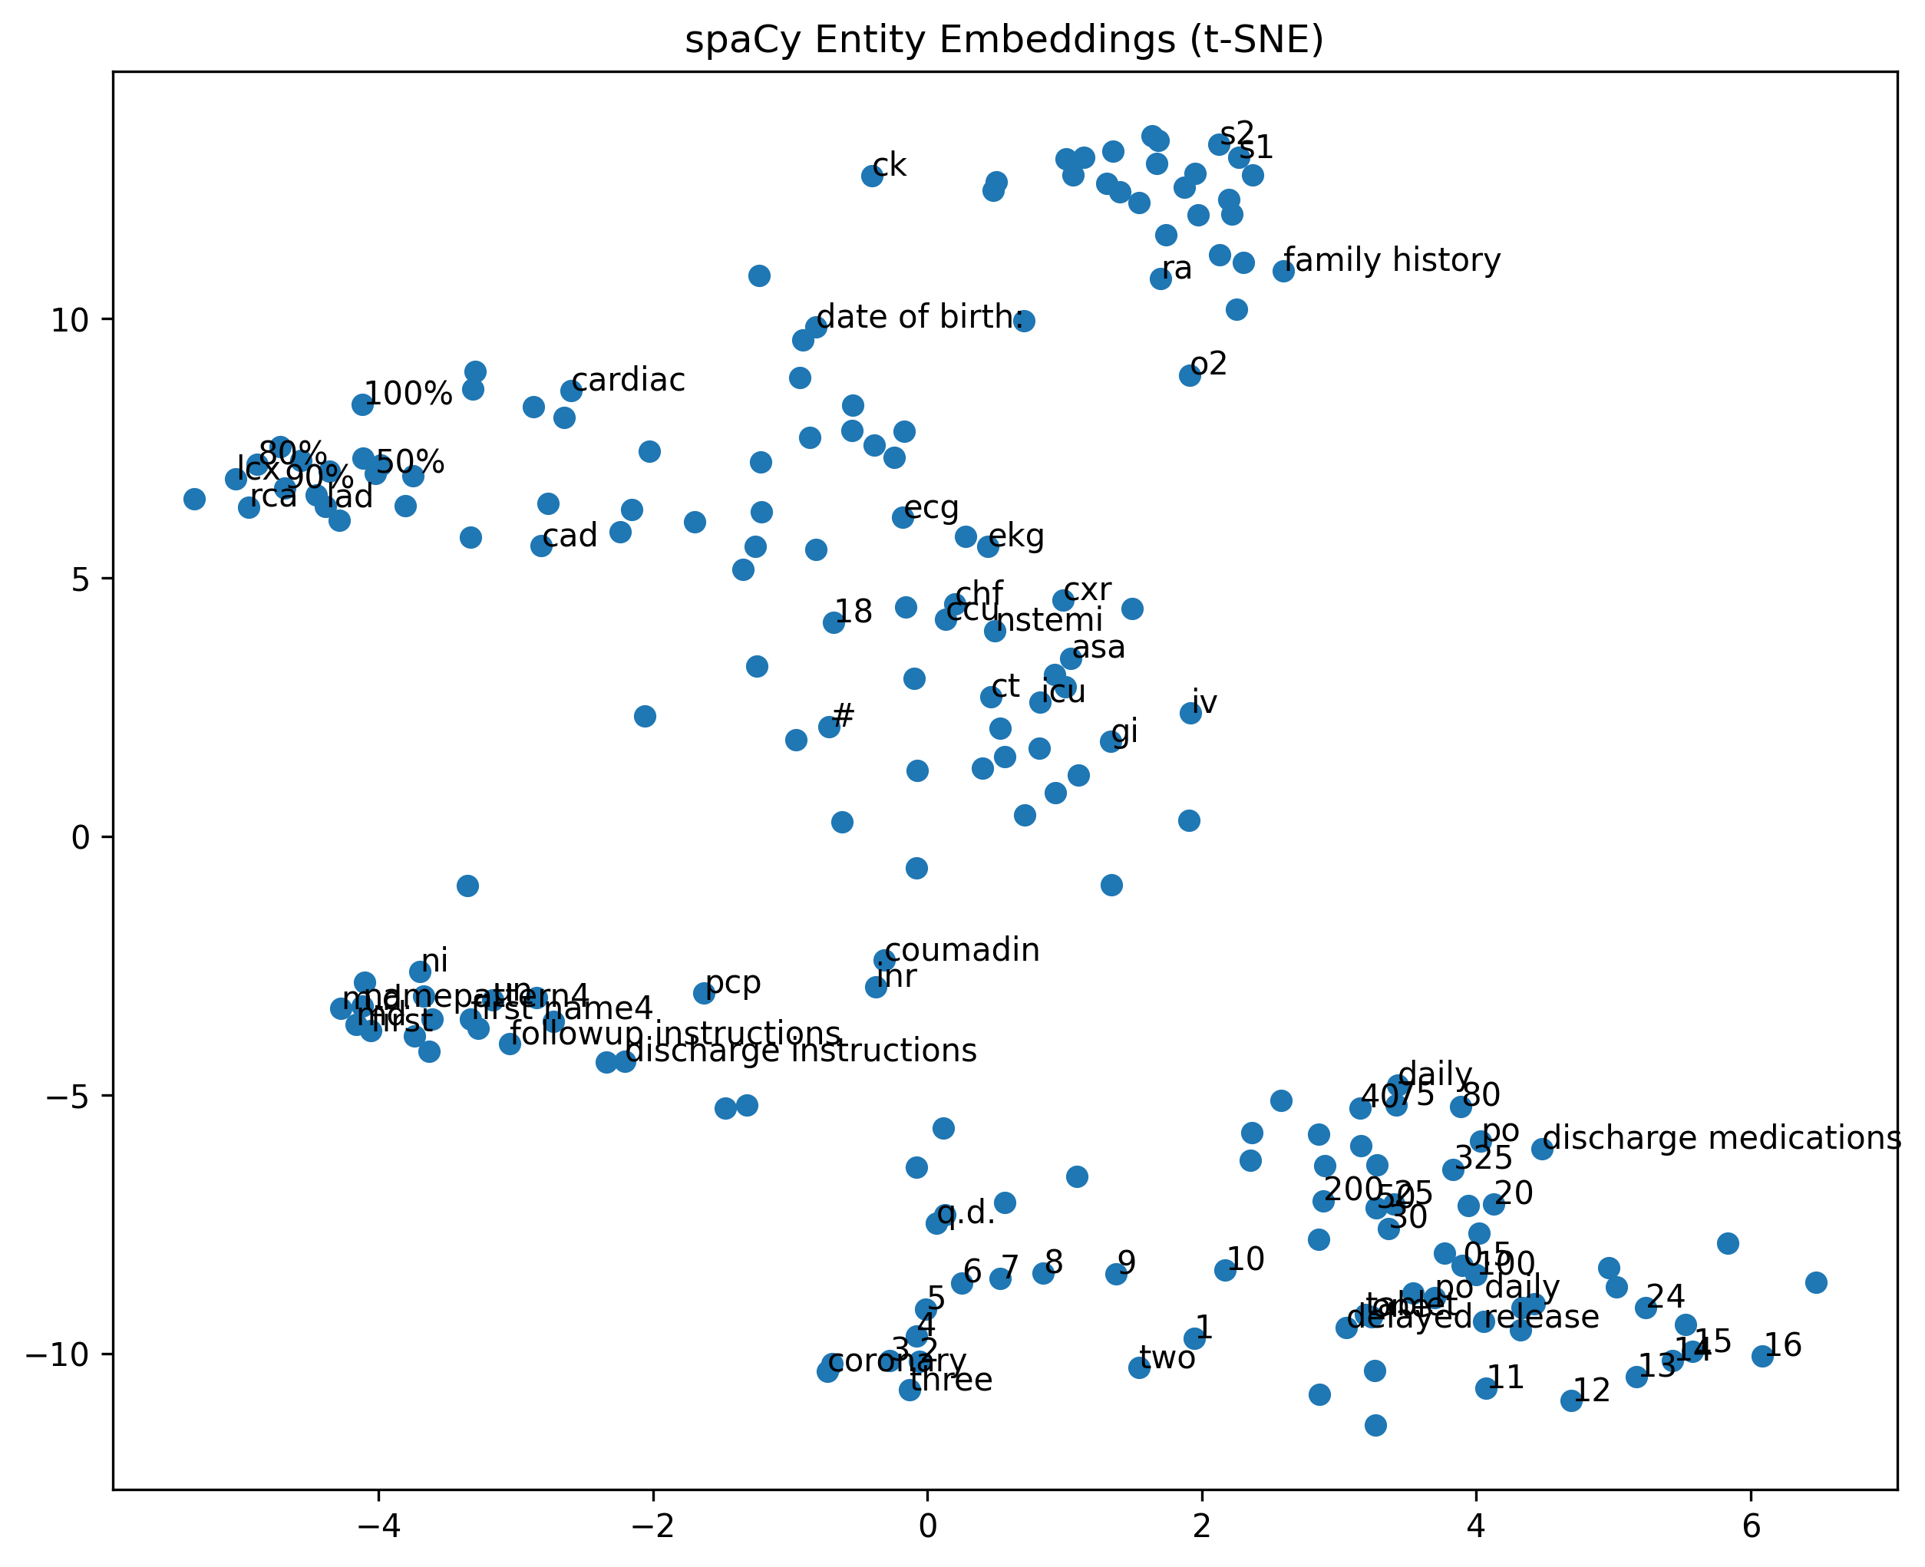
01. tSNE Plot for spaCy Entity Embeddings

Slide 8
NER and Word2Vec in spaCy
NER used en_core_web_sm model
Trained on general news/web data
Extracts names, dates, numbers, organizations
Weak biomedical recognition
Word2Vec Embeddings
Static, non-clinical
Limited medical semantic alignment

Slide 9
Code
import spacy
from spacy import displacy
nlp_spacy = spacy.load("en_core_web_sm")
spacy_entities_docs = []
for doc in nlp_spacy.pipe(texts, batch_size=10):
entities = [ent.text.lower() for ent in doc.ents]
spacy_entities_docs.append(entities)
doc_example = nlp_spacy(texts[0])
displacy.render(doc_example, style="ent", jupyter=True)
w2v_spacy = Word2Vec(
sentences=spacy_entities_docs,
vector_size=100,
window=5,
min_count=3,
workers=4
)

Slide 10
Observation and Interpretation
Diffused clustering structure
Significant inclusion of numeric tokens (e.g., 10, 20, 50%)
Administrative phrases (e.g., discharge instructions, followup instructions)
Date-related entities (more prominent in dispaCy visualization)
Some clustering of cardiovascular terms (cad, cardiac, coronary)
Clusters are less clinically coherent
Captures structural entities but lacks sensitivity to AMI-specific terminology
Under-detection of cardiology-relevant concepts

Slide 11
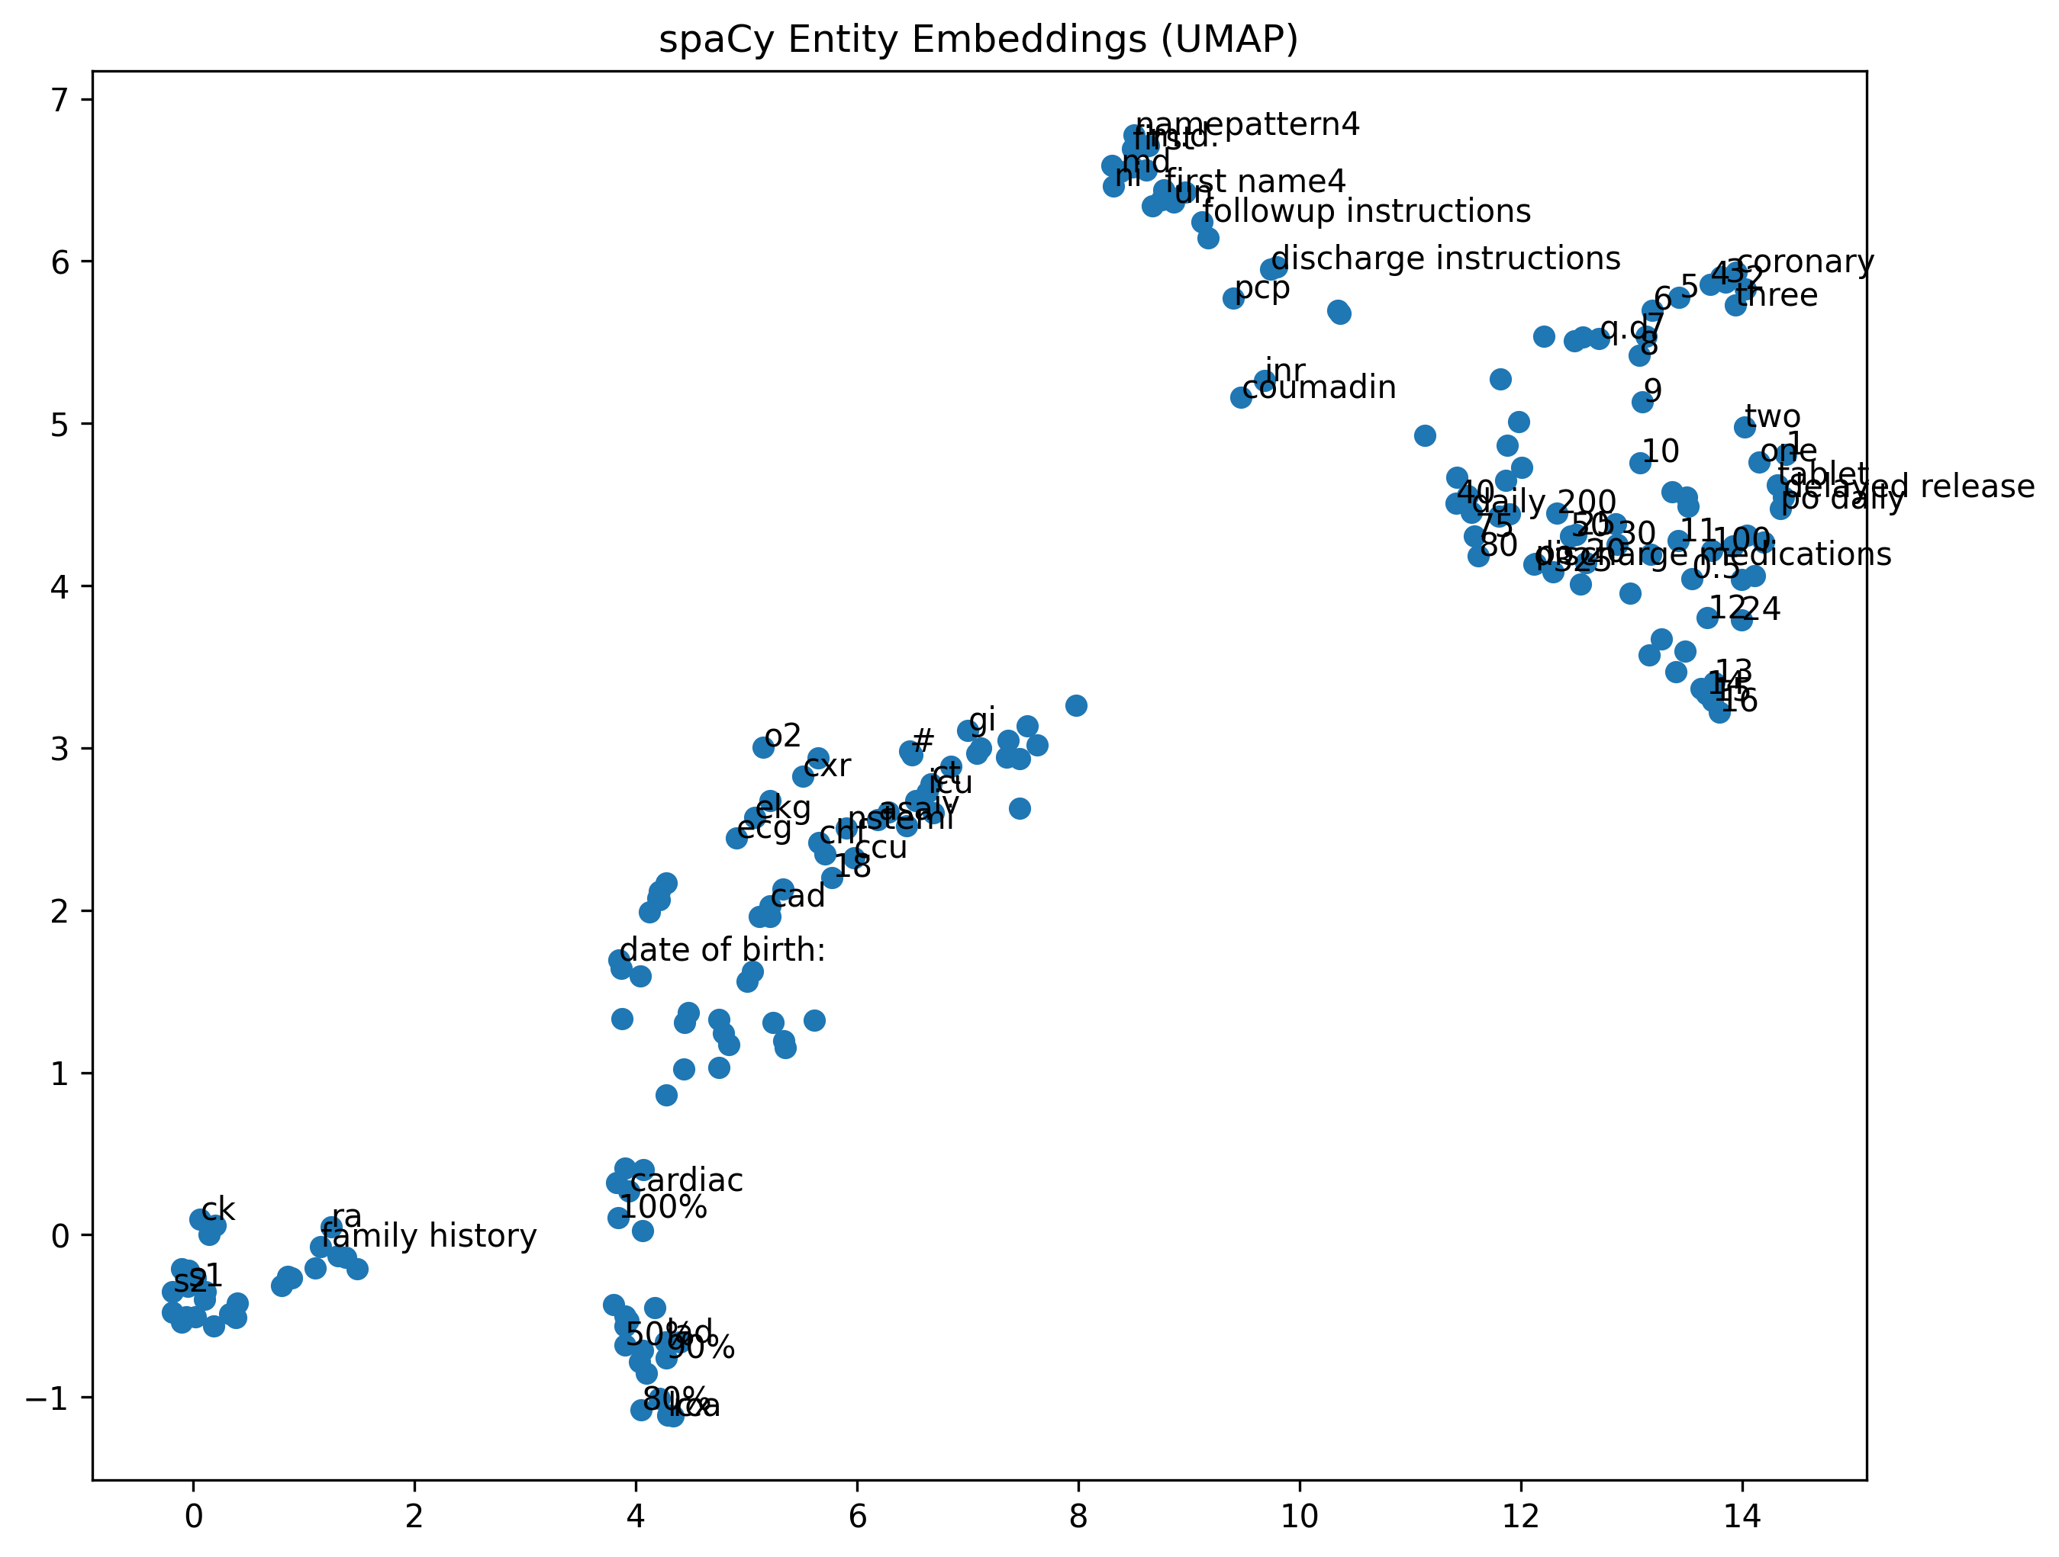
02. UMAP Plot for spaCy Entity Embeddings

Slide 12
Observation and Interpretation
Clearer grouping than t-SNE
Clusters dominated by numeric entities
Administrative phrases (e.g., discharge instructions, followup instructions)
Mixed clinical and non-clinical grouping
Mild clustering of cardiac terms (cad, chf, ekg, ecg)
Domain specificity remains limited

Slide 13
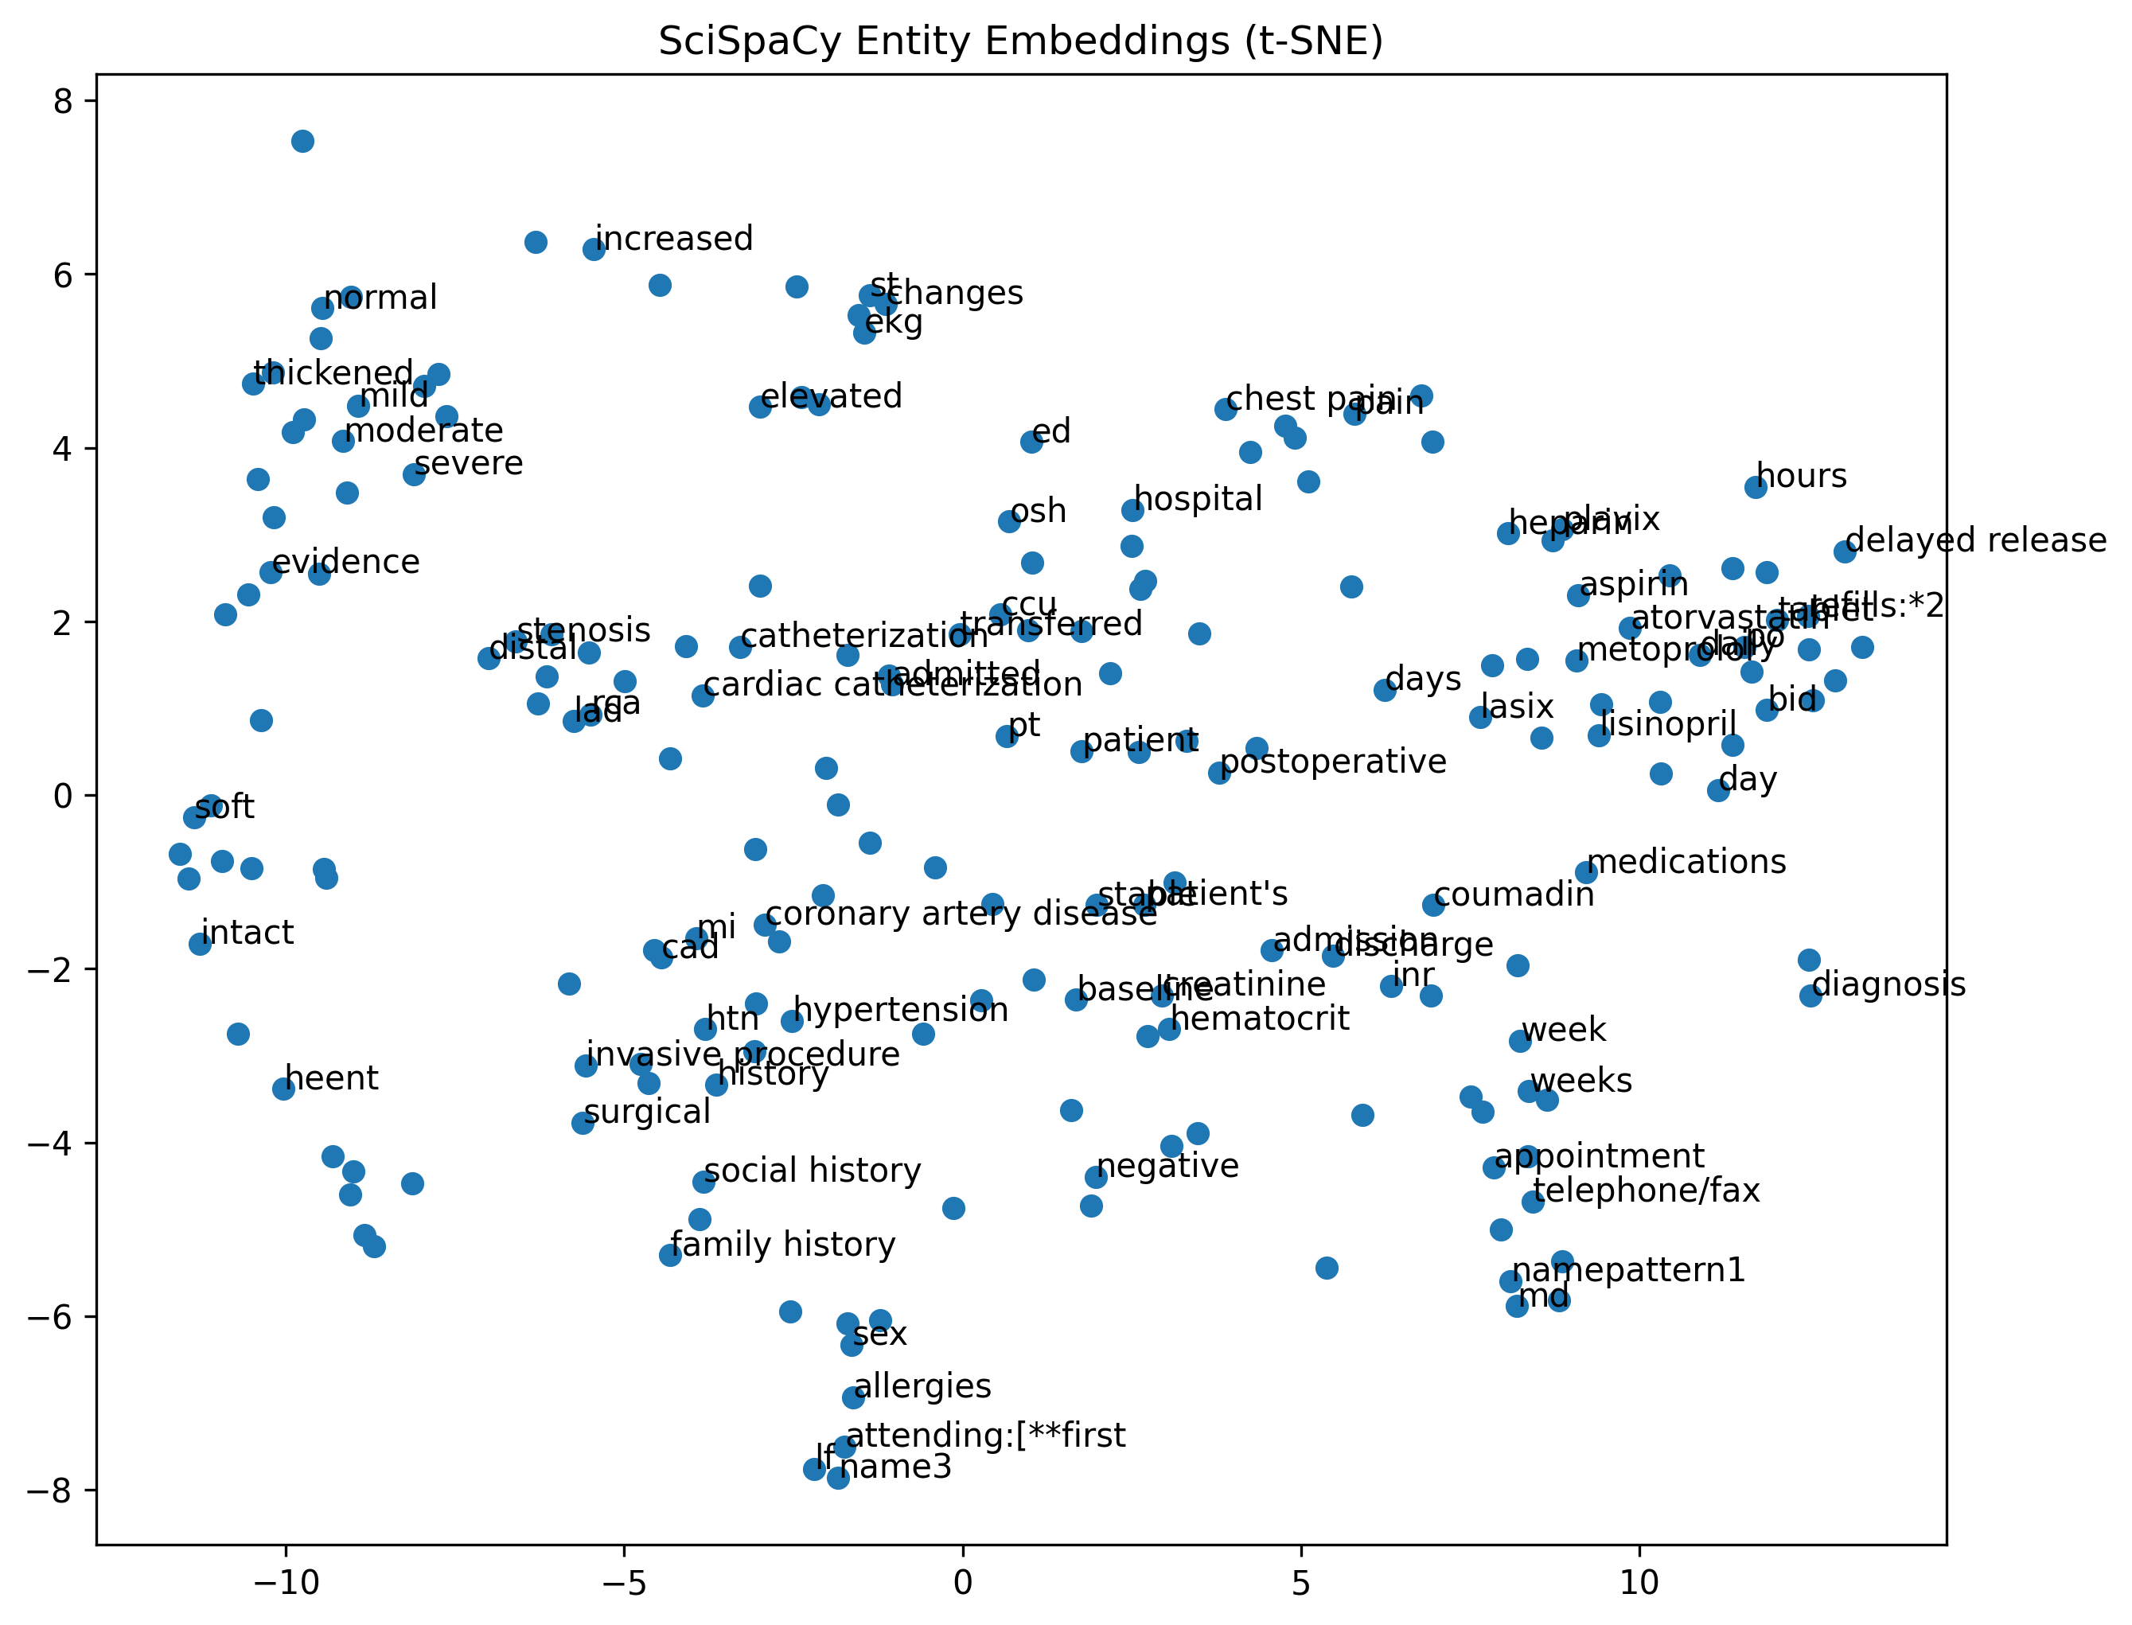
03. tSNE Plot for scispaCy Entity Embeddings

Slide 14
NER and Word2Vec used in scispaCy
NER used en_core_sci_md model
Trained on biomedical corpora
Recognizes diseases, anatomy, chemicals
Better medical specificity
Word2Vec Embeddings
Biomedical vocabulary
Improved co-occurrence learning

Slide 15
Code
import spacy
from spacy import displacy
nlp_sci = spacy.load("en_core_sci_md")
scispacy_entities_docs = []
for doc in nlp_sci.pipe(texts, batch_size=10):
entities = [ent.text.lower() for ent in doc.ents]
scispacy_entities_docs.append(entities)
scispaCydoc_example = nlp_sci(texts[0])
displacy.render(scispaCydoc_example, style="ent", jupyter=True)
w2v_sci = Word2Vec(
sentences=scispacy_entities_docs,
vector_size=100,
window=5,
min_count=3,
workers=4
)

Slide 16
Observation and Interpretation
Mild clusters observed –
Medication cluster (aspirin, metoprolol, atorvastatin, heparin)
Cardiovascular disease cluster (cad, coronary artery disease, hypertension)
Severity modifiers (mild, moderate, severe)
Significantly improved clinical specificity
Reduction of administrative noise (e.g., discharge instructions, follow up instructions)
Indicates improved biomedical concept recognition

Slide 17
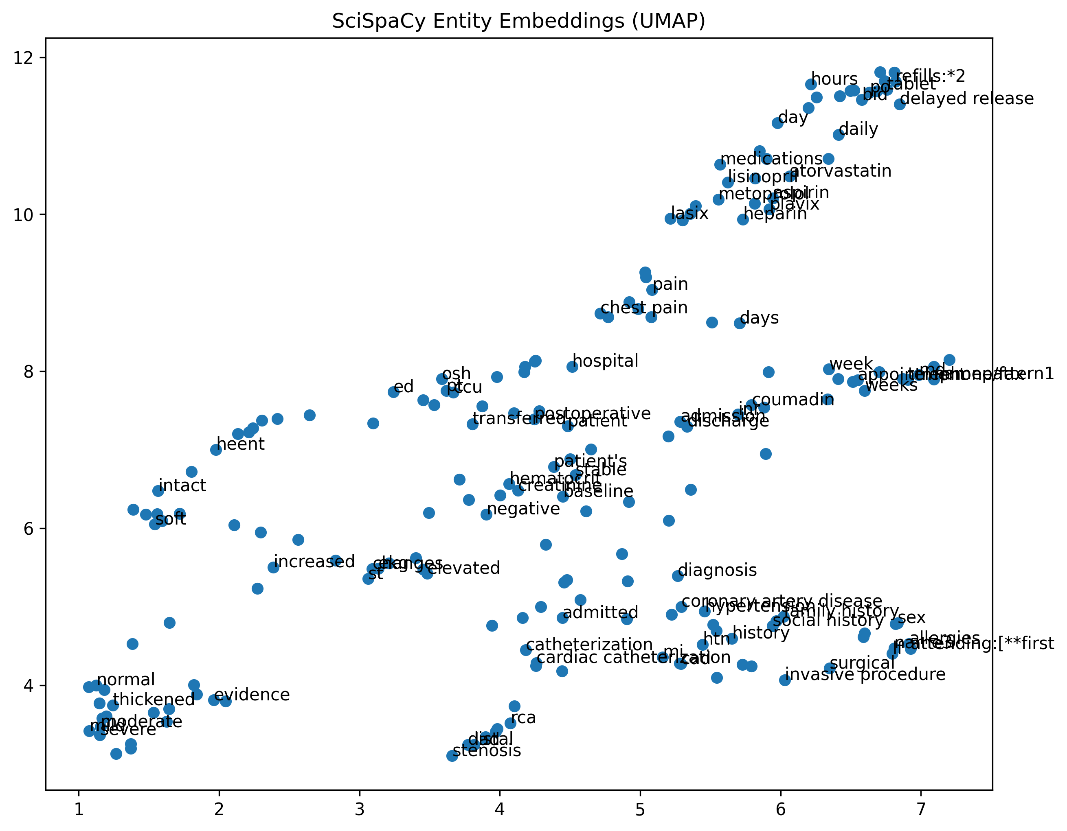
02. UMAP Plot for scispaCy Entity Embeddings

Slide 18
Observation and Interpretation
UMAP produces clearer macro-structure:
Medication-related entities grouped tightly
Disease-related terms grouped separately
Procedural terms (catheterization, surgery) forming localized groupings
Global organization is more interpretable than spaCy
Conceptual neighborhoods visible
SciSpaCy effectively captures biomedical semantic relationships, demonstrating:
Stronger domain alignment
Improved cluster separation
Meaningful cardiovascular subdomain segmentation

Slide 19
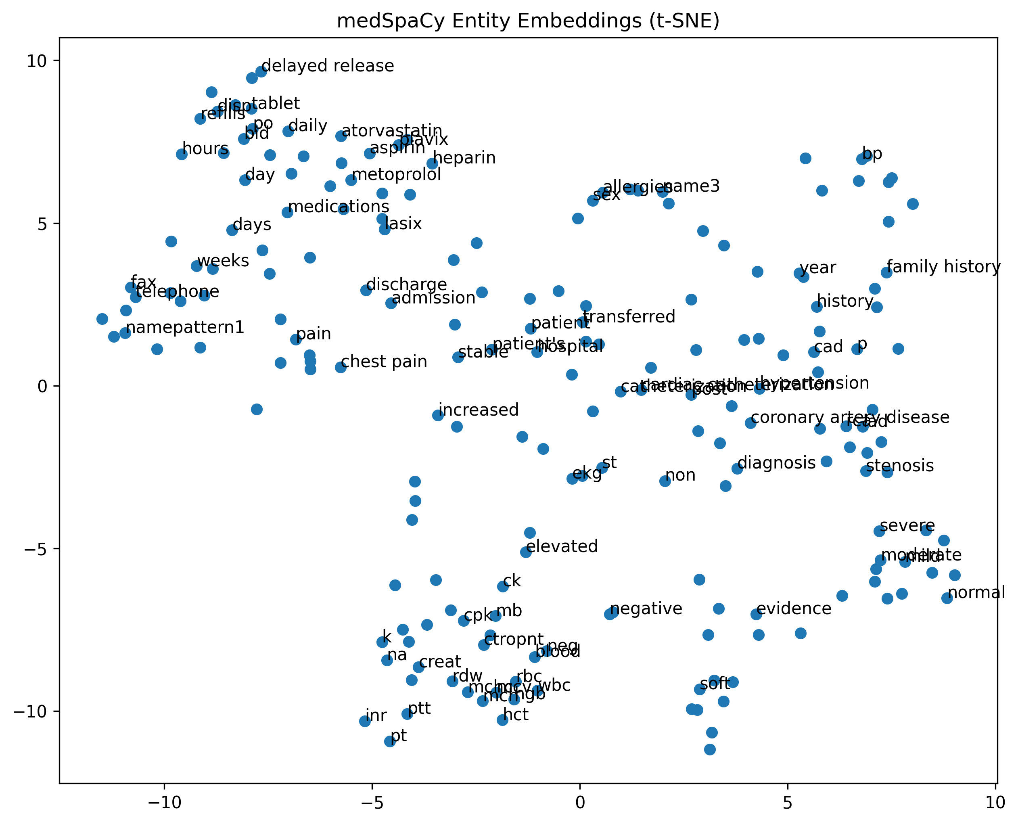
05. tSNE Plot for medspaCy Entity Embeddings

Slide 20
NER and Word2Vec used in medspaCy
NER used en_core_sci_md model
Rule-enhanced clinical extraction
Focused on real EHR structure
Reduced administrative noise
Improved entity precision
Word2Vec Embeddings
Similar static embedding base
Cleaner entity input

Slide 21
Code
import medspacy
nlp_med = medspacy.load("en_core_sci_md", disable=["parser"])
medspacy_entities_docs = []
for doc in nlp_med.pipe(texts, batch_size=10):
entities = [ent.text.lower() for ent in doc.ents]
medspacy_entities_docs.append(entities)
medspacydoc_example = nlp_med(texts[0])
displacy.render(medspacydoc_example, style="ent", jupyter=True)
w2v_med = Word2Vec(
sentences=medspacy_entities_docs,
vector_size=100,
window=5,
min_count=3,
workers=4
)

Slide 22
Observation and Interpretation
medSpaCy demonstrates the strongest clinical coherence among the entity models.
Clusters correspond directly to clinical reasoning categories:
Biomarkers (troponin, CK, INR)
Disease states (CAD, stenosis, hypertension)
Medications (aspirin, statins, beta-blockers)
Procedures (cardiac catheterization)
Best reflects real-world AMI care components
More compact clusters than sciSpacy
Administrative entities are minimal (e.g., discharge instructions, follow up instructions)

Slide 23
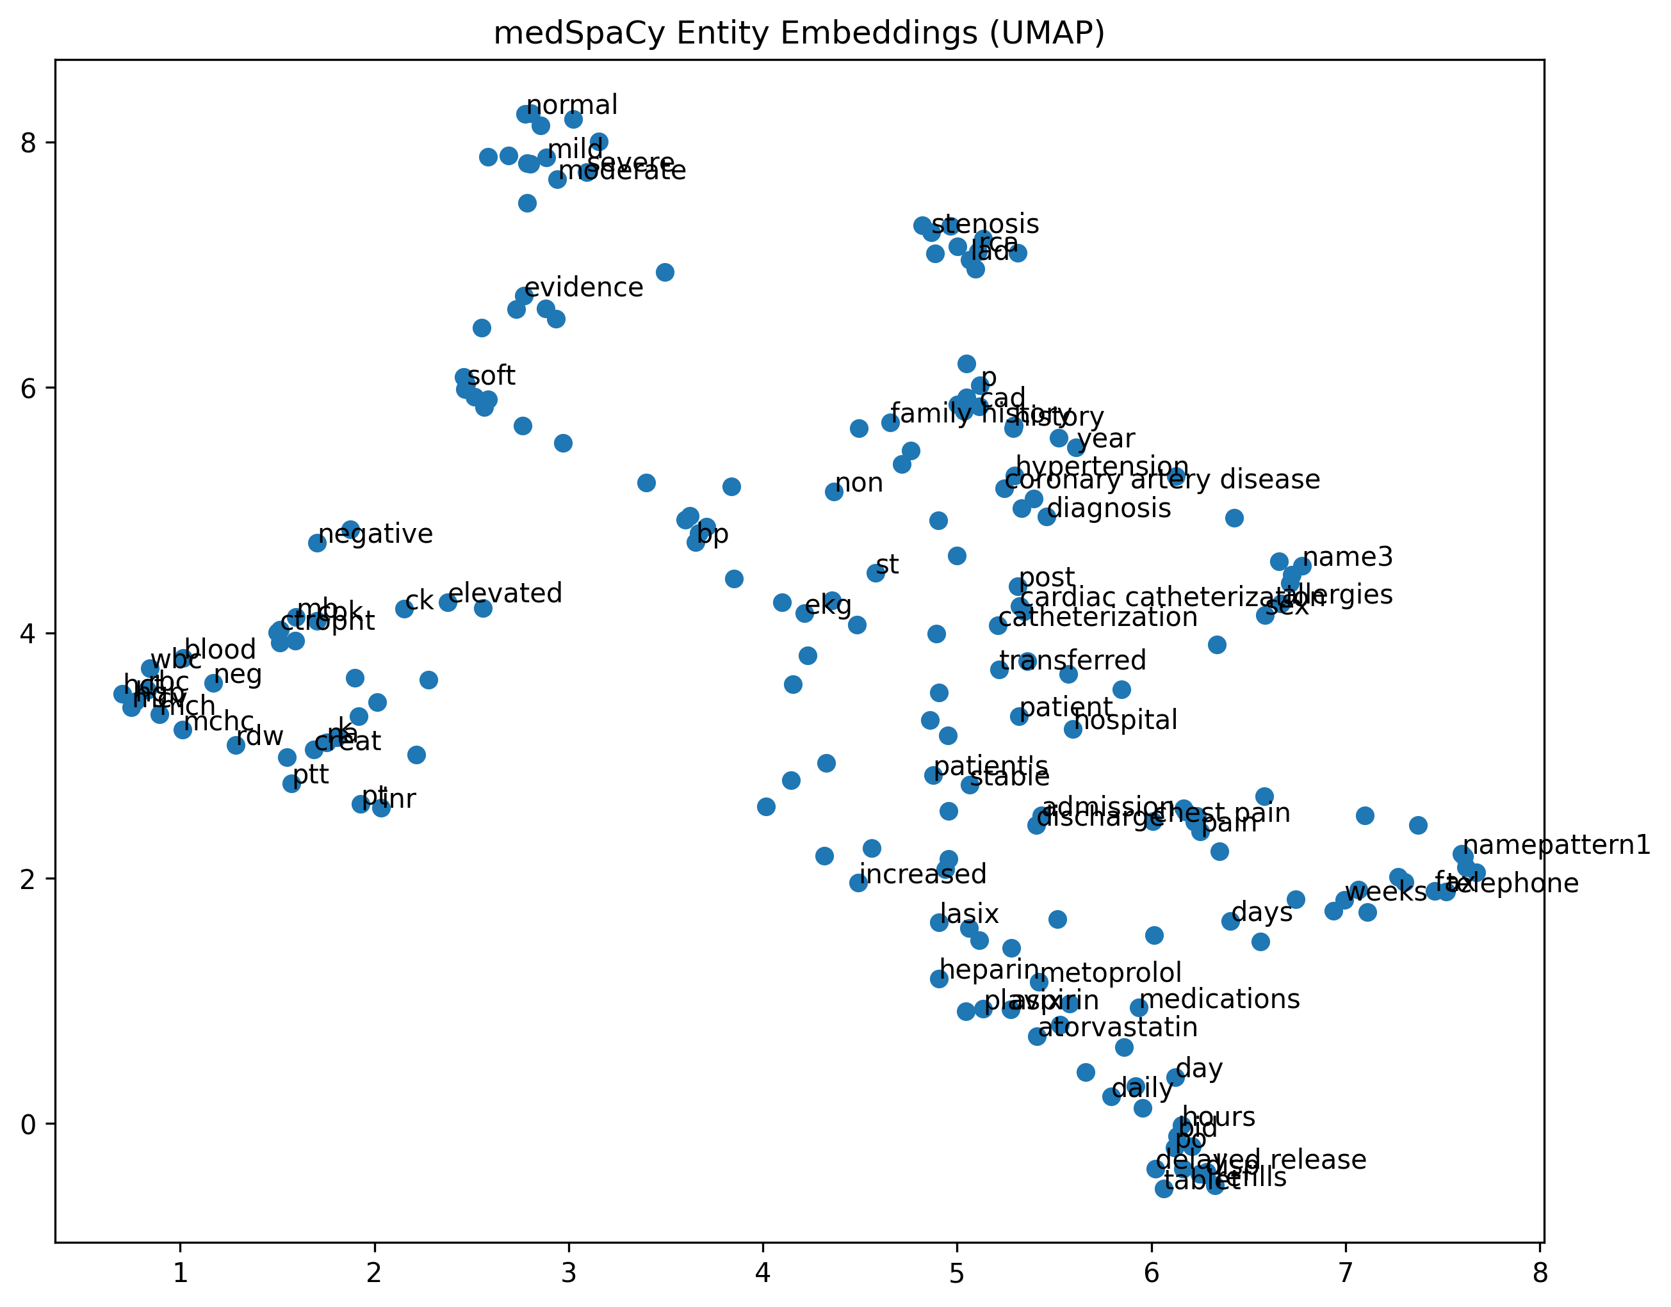
06. UMAP Plot for medspaCy Entity Embeddings

Slide 24
Observation and Interpretation
Well defined clinical sub-domains
Tight lab value cluster
Distinct severity cluster
Tight pharmacologic cluster
Procedural cluster (cardiac catheterization etc.)
Cluster boundaries are sharper than both spaCy and SciSpaCy
Reduced semantic overlap
medSpaCy provides the most clinically interpretable embedding space

Slide 25
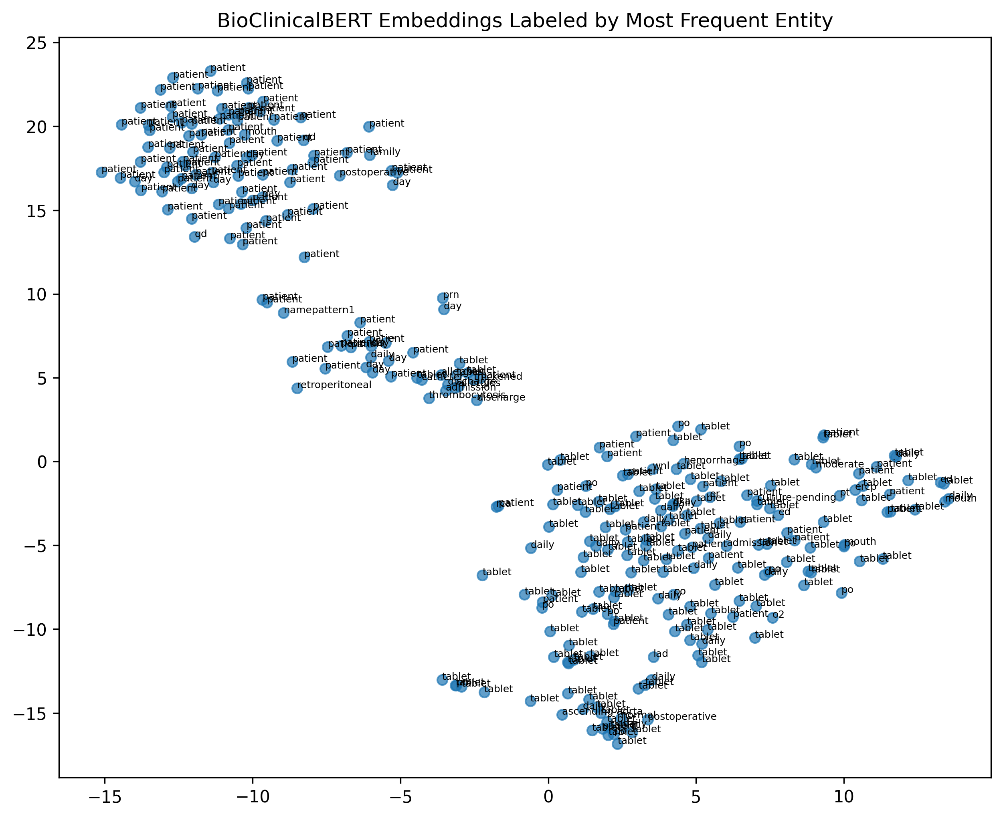
07. tSNE Plot for BioClinialBERT Embeddings

Slide 26
NER and Embeddings
NER
Not inherently performing NER
Uses full text directly
No explicit entity filtering
Embeddings
Contextual transformer embeddings
Sentence-level semantics
Section-aware representation
Contextual embeddings can capture high-level document semantics without explicit NER.

Slide 27
Code
def get_mean_embedding(text):
inputs = tokenizer(
text[:512],
return_tensors="pt",
truncation=True,
padding=True
)
with torch.no_grad():
outputs = model(**inputs)
last_hidden = outputs.last_hidden_state
attention_mask = inputs["attention_mask"]
mask = attention_mask.unsqueeze(-1).expand(last_hidden.size()).float()
masked_embeddings = last_hidden * mask
mean_embedding = masked_embeddings.sum(1) / mask.sum(1)
return mean_embedding.squeeze().numpy()
bert_embeddings = np.vstack([get_mean_embedding(t) for t in sample_texts])

Slide 28
Code
from collections import Counter
def most_frequent_entity(entities):
"""
entities: list of entity strings extracted from a single document
returns: most frequent entity string
"""
if not entities:
return "none"
normalized = [e.lower().strip() for e in entities]
counts = Counter(normalized)
most_common_entity = counts.most_common(1)[0][0]
return most_common_entity
primary_labels = []
for ents in scispacy_entities_docs[:len(tsne_embedding)]:
if len(ents) > 0:
# primary_labels.append(ents[0])
primary_labels.append(most_frequent_entity(ents))
else:
primary_labels.append("none")

Slide 29
Observation and Interpretation
The BioClinicalBERT document-level t-SNE plot reveals two major clusters:
Cluster A:
Dominated by generic entities (e.g., “patient”)
Cluster B:
Dominated by medication-related labels (“tablet”, “daily”)
Prescription and medication reconciliation sections
The clustering is strong and visually distinct.
Unlike entity-level models, BioClinicalBERT captures:
Document-level semantics
Section-level structure
Embeddings demonstrates strong contextual representation learning

Slide 30
Summary and Model Comparison
The analysis demonstrates
Domain adaptation significantly improves entity embedding interpretability
Dimensionality reduction techniques (t-SNE, UMAP) effectively reveal latent clinical organization
Model comparison
spaCy lacks domain specificity and produces noisy clusters
sciSpaCy improves biomedical coherence significantly
medSpaCy provides the cleanest and most clinically meaningful entity clustering
BioClinicalBERT captures high-level document semantics rather than entity similarity.

Slide 31
Comparison Chart
Aspect | spaCy | scispaCy | medspaCy | BioClinicalBERT
Entity Precision | Low | Moderate | High | N/A
Domain Awareness | Low | High | Very High | Very High
Embedding Type | Static | Static | Static | Contextual
Context Sensitivity | No | No | No | Yes
Cluster Clinical Coherence | Weak | Strong | Very Strong | Strong (document-level)

